Slide 1
Final Project Report
Digital Business
2022 CS-5270 Cloud Native Development
Group10： 游智鈞/高承翰/詹銍傑/官學勤/廖家鴻 2022/6/8

Slide 2
Outline
Introduction
Basic
Application Architecture
Code Optimization
Testing Coverage
CI/CD
Option
App Monitor
Database
Code Contribution
Discussion
Conclusion

Slide 3
Introduction
(廖家鴻)

Slide 4
Requirement Coverage
Type | Category | Remark
Basic | Upload codes to Github
 | Deploy to GKE
 | Digital Business: Internet volume changes
 | Application Architecture
 | Code Optimization
 | Testing Coverage
 | CI / CD
Option | Application Monitor
 | Use Database
 | Code Contribution
 | Ingress

Slide 5
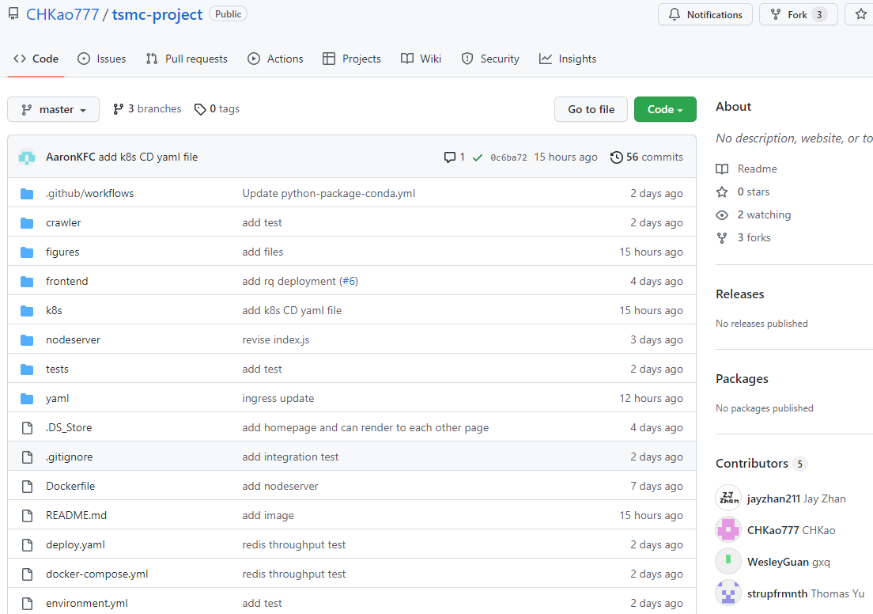
Upload codes to Github
Github link: https://github.com/CHKao777/tsmc-project

Slide 6
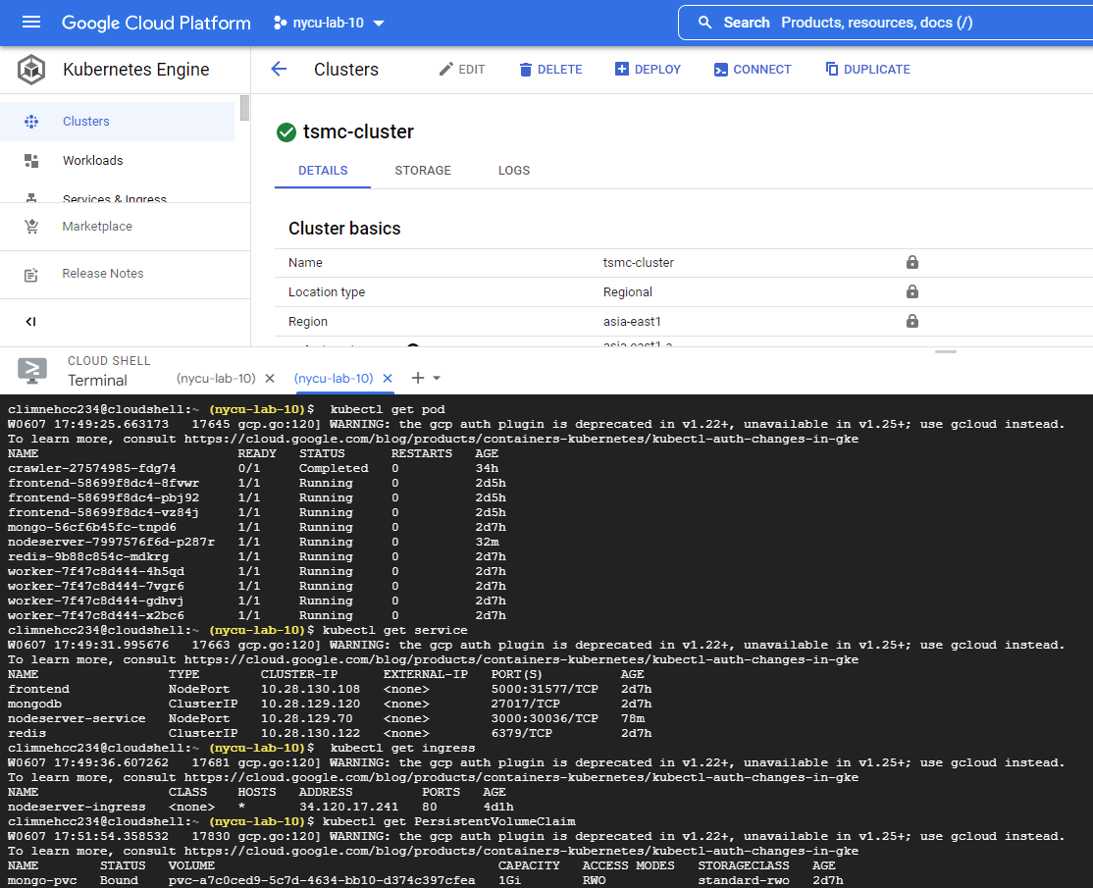
Deploy
to
GKE
Pods
Services
Ingress
Database

Slide 7
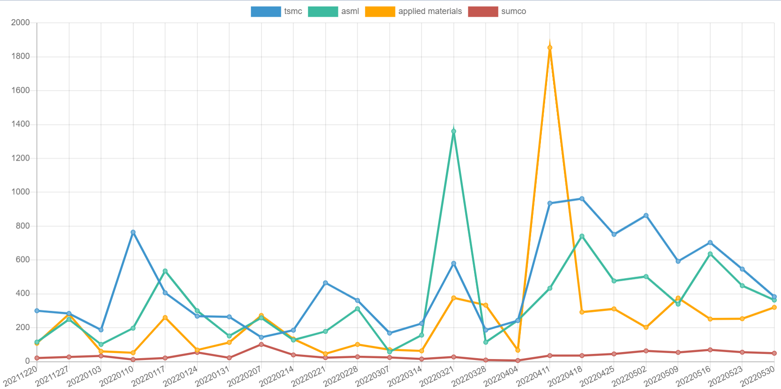
Digital Business: Internet Volume (word count)
Digital Business
Service link: http://34.120.17.241/wordcount
Notes:
我們是weekly的爬蟲，有search到的url幾乎都爬下來count了

Slide 8
Application Architecture
(游智鈞)

Slide 9
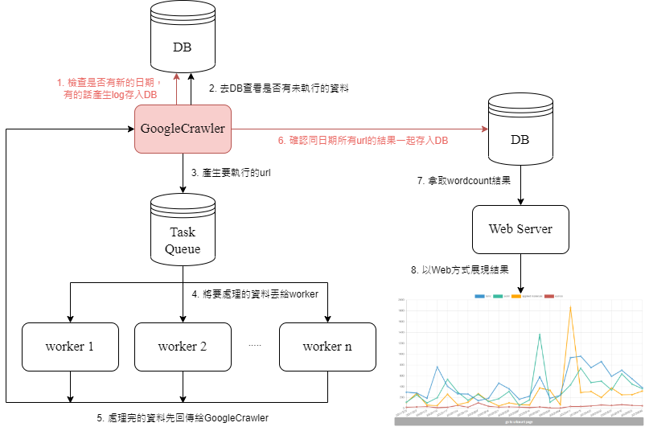
Application Architecture

Slide 10
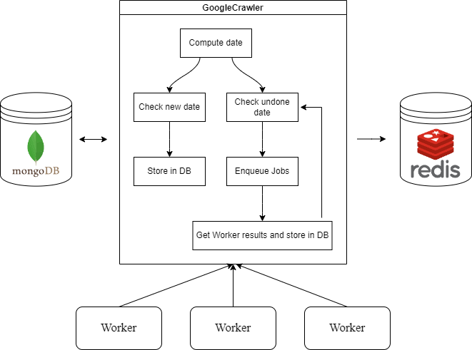
Application Architecture
GoogleCrawler

Slide 11
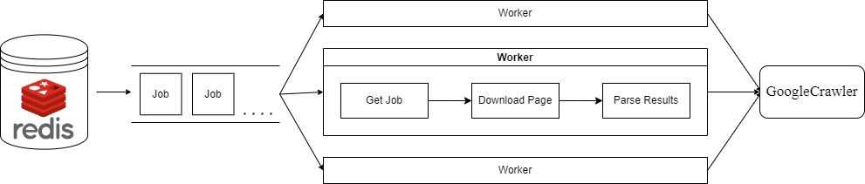
Application Architecture
Crawler

Slide 12
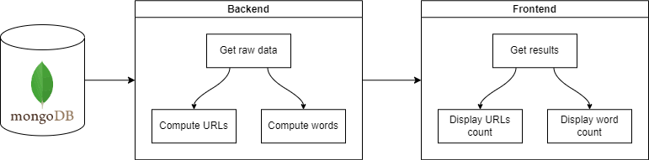
Application Architecture
Web Server

Slide 13
Code Optimization
(官學勤)

Slide 14
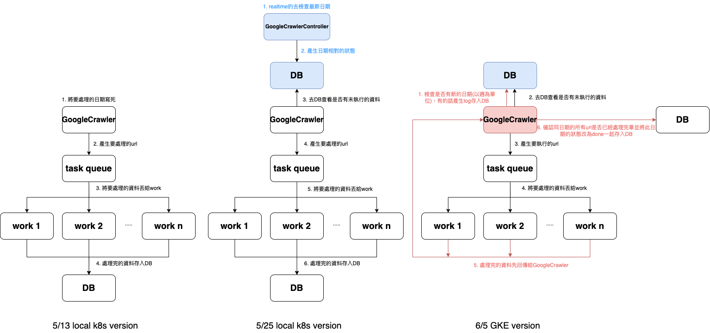
Code Optimization
Notes:
我們在實作第二版時當work算完這個url的work count時就將結果寫入DB，當crawler 中斷或是work有異常時，我們在重啟之後會不知道要從task queue的哪個url繼續執行，所以我們在第三版的設計將work的結果一併傳給crawler，當crawler將這週資料全部一起存入DB
還有原本我們是有一個googleCrawlerController一直去跑然後抓最新的時間，最終實作是利用GKE上的排程功能來設定時間讓googleCrawler時間到就去更新DB

Slide 15
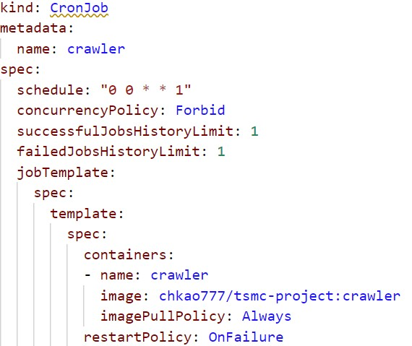
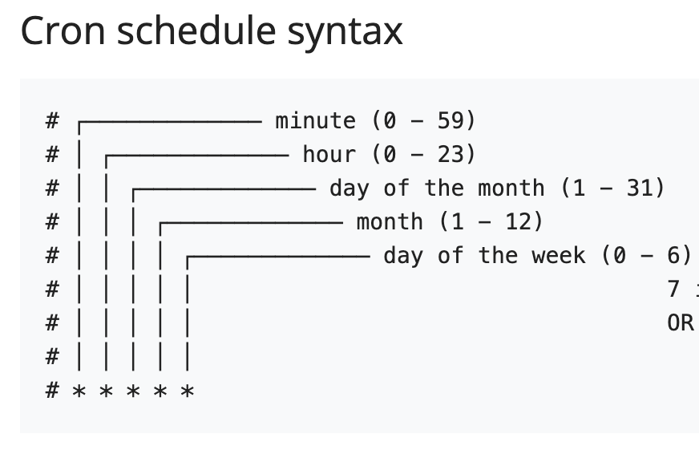
CronJob
At 00:00 on Monday.
Notes:
我們的設計是以一週為單位禮拜一到禮拜天，當現在時間到禮拜一之後googleCrawler就會自動去執行並將禮拜一日期和狀態存入DB

Slide 16
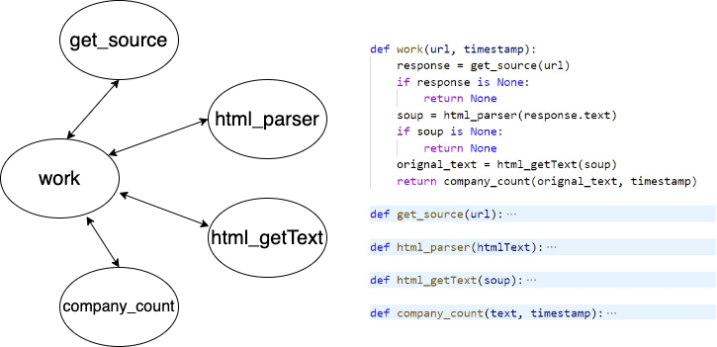
Simple Responsibility Principle

Slide 17
Testing Coverage
(詹銍傑)

Slide 18
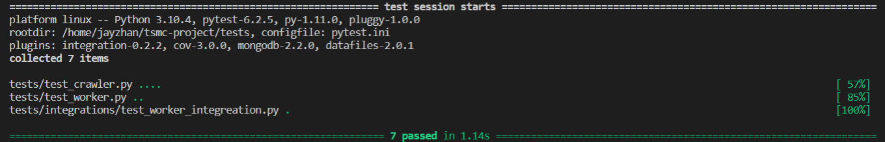
Unit test
Test Worker
Company count
Get HTML Text (Only get word in paragraph)
Test Crawler
Add new date
Get first weekday (Monday)
Test with Mongodb (pytest-mongodb)

Slide 19
Integration test
Test worker
URL: 'https://www.taipeitimes.com/News/biz/archives/2022/01/20/2003771688'
tsmc: 4, asml: 7

Slide 20
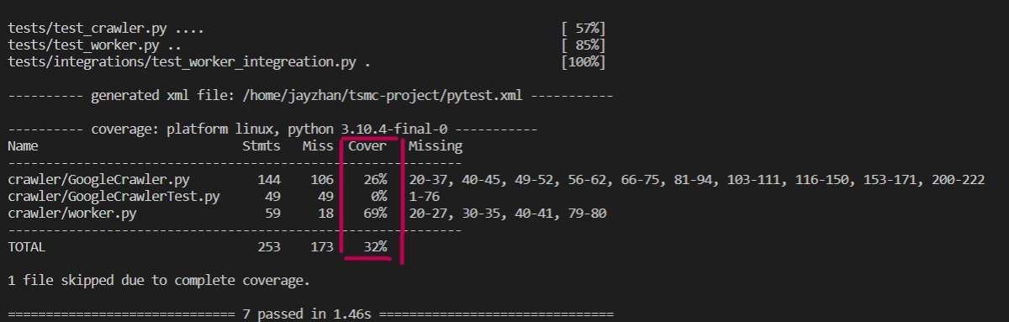
Testing Coverage
GoogleCrawler.py Coverage 26%
GoogleCrawlerTest.py Coverage 0% (Not used)
worker.py Coverage 69%
Total Coverage 32%

Slide 21
CI / CD

Slide 22
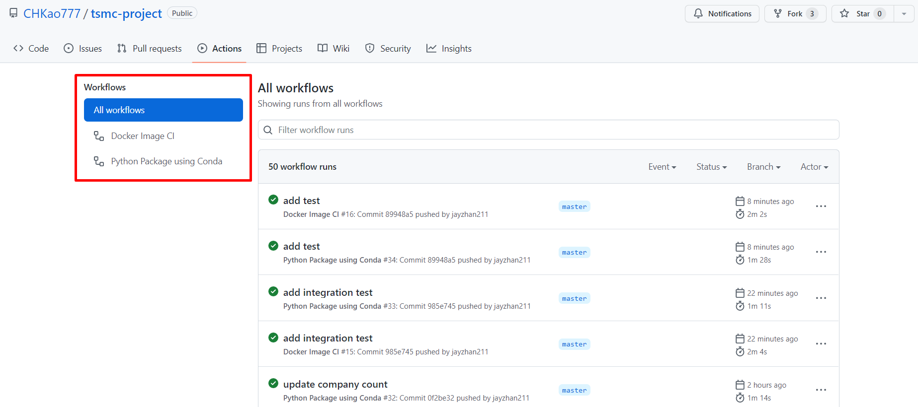
Github Action

Slide 23
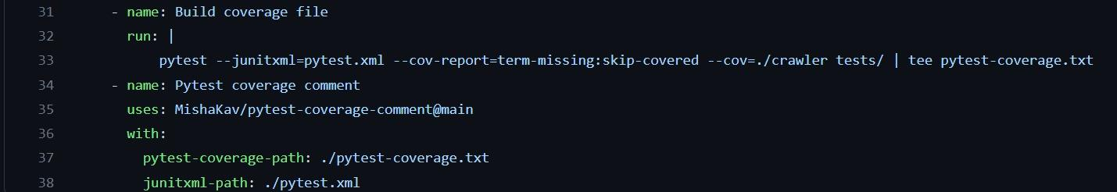
Pytest Coverage
Run pytest-conv
Read pytest-coverage.txt

Slide 24
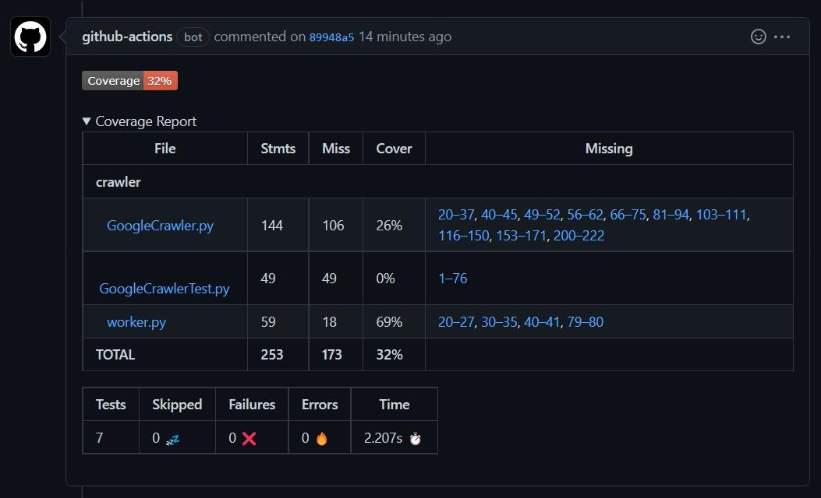
Pytest Coverage
Github-actions Coverage Report
TOTAL COVERAGE: 32%

Slide 25
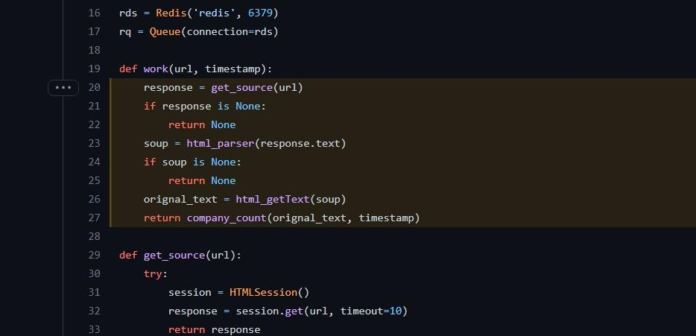
Pytest Coverage
Github-actions Coverage Report
TOTAL COVERAGE: 32%
MISSING: Line Not Covered

Slide 26
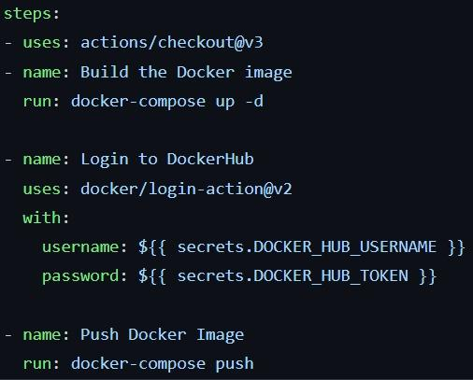
Github Action: Continuous Push Docker Image
Run docker-compose to build Docker image
Login to Docker Hub
Set Docker Hub Username and Token to github
Run login-action
Push Docker image

Slide 27
Option
(高承翰)

Slide 28
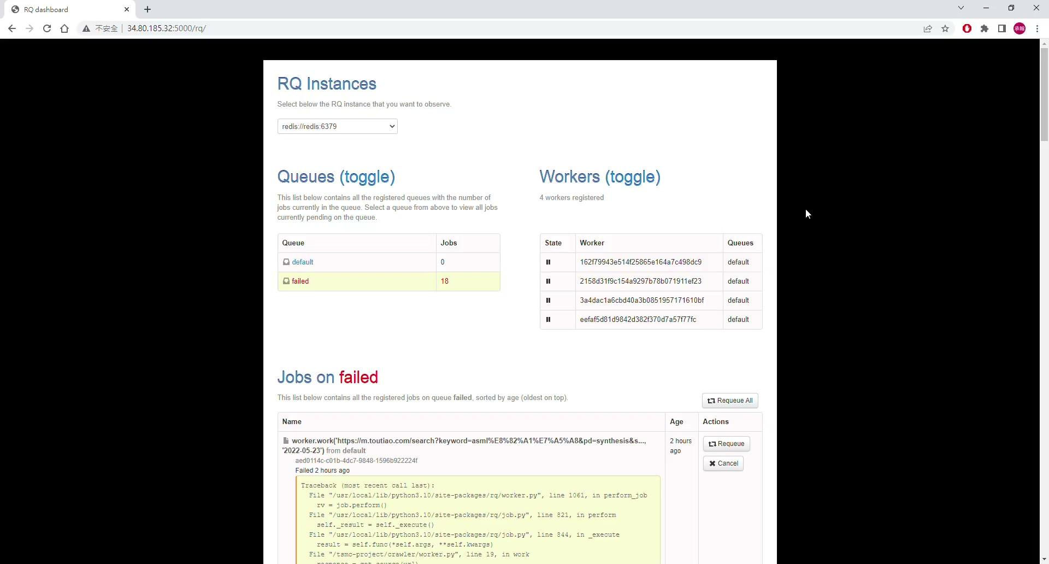
App Monitor: RQ dashboard

Slide 29
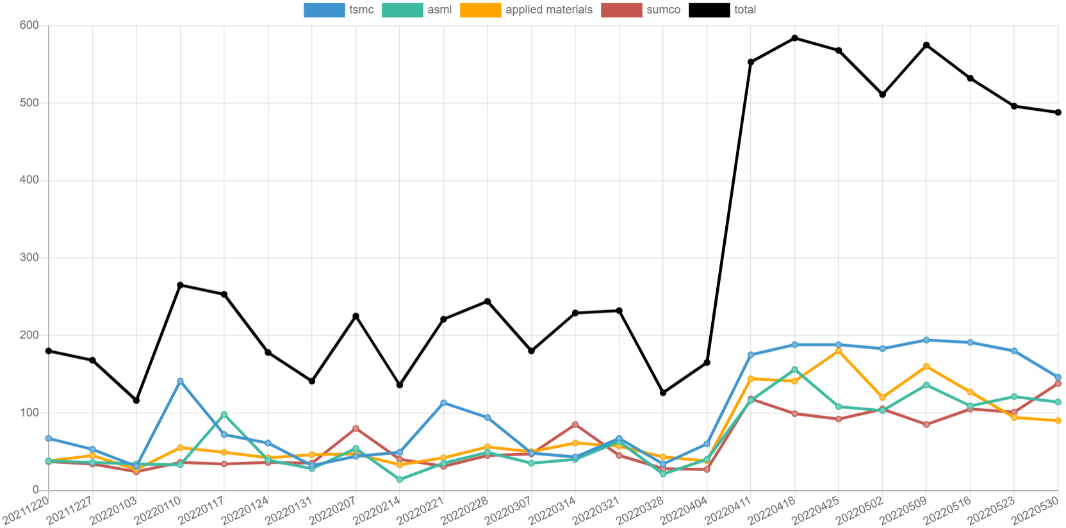
App Monitor -- week url counts

Slide 30
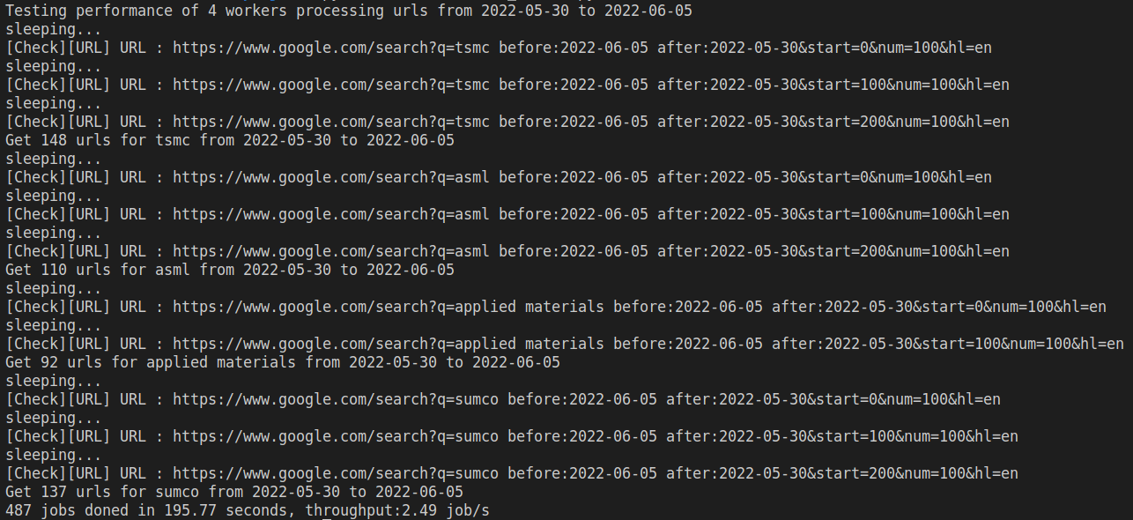
App Monitor: worker performance

Slide 31
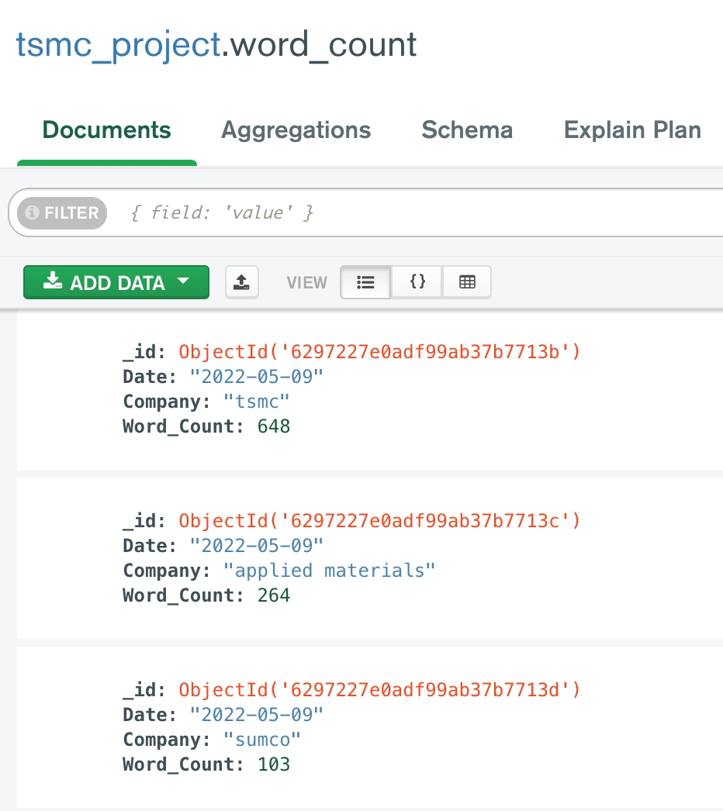
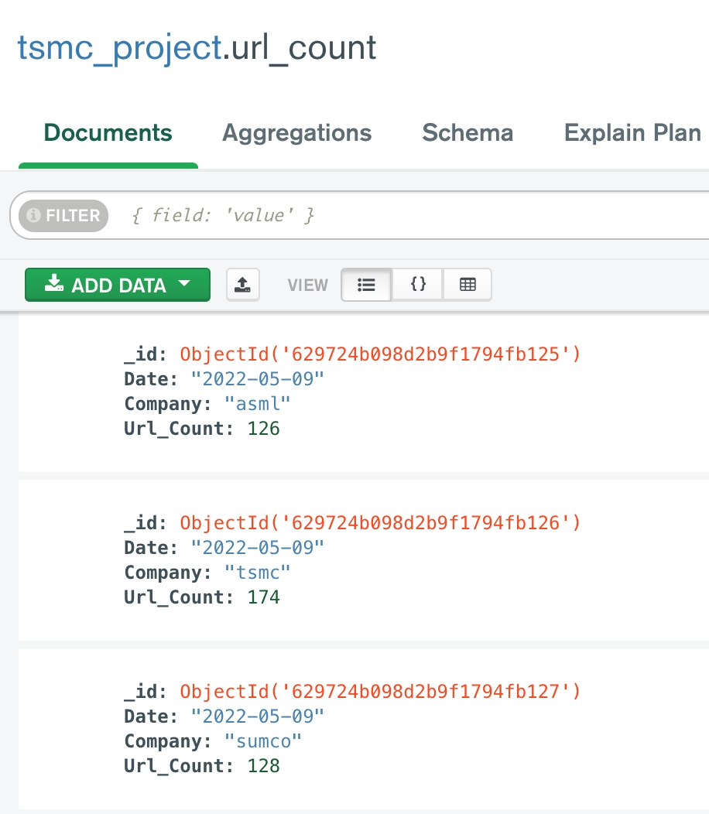
Database Schema

Slide 32
Code Contribution
 | Type | Sample Code | Our Application
1 | Google Search | Search by default | Search by week
2 | Word Count | ✔ | ✔
3 | URL Count | ❌ | ✔
4 | Task Queue | ❌ | ✔
5 | Testing | Unit test | Unit test + Integration test
6 | Database | ❌ | MongoDB
7 | Display | Excel | Web Page
8 | Evaluate Performance | ❌ | ✔
9 | Update | ❌ | Every week

Slide 33
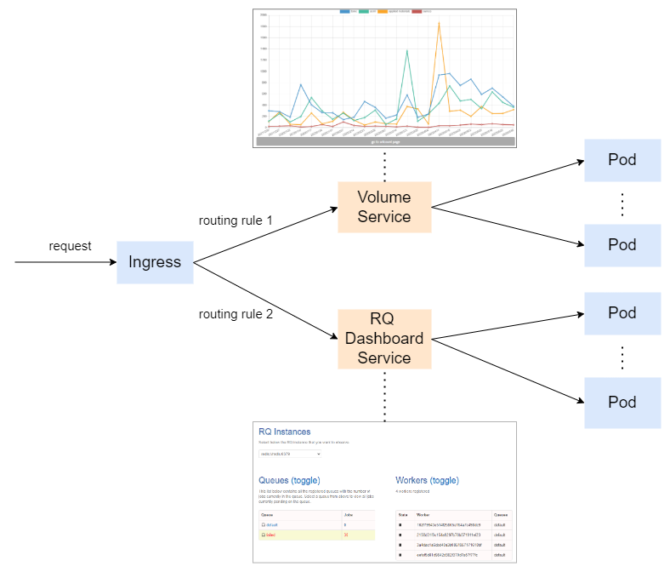
Ingress

Slide 34
Discussion
(廖家鴻)
Notes:
一些觀察
和remaining questions

Slide 35
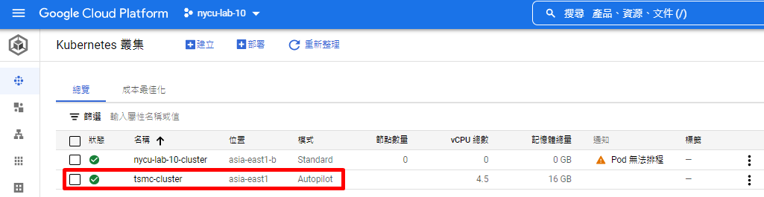
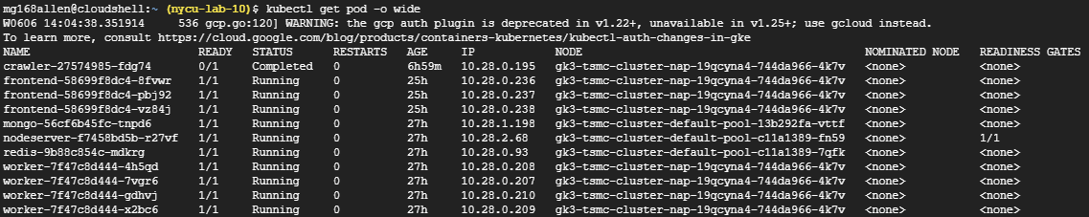
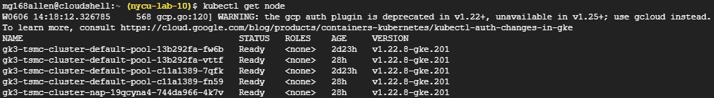
GKE Autopilot Deployment
Pods
Nodes
Notes:
我們本來想說除了介紹整個application的architecture外，還想劃一下實際在GKE上的部署。
但結果發現，用Autopilot開的cluster，看起來沒辦法控制node的部署。
從截圖是可以看的出哪個pod是佈在哪個node，但不知道這個判斷的機制是什麼？也不知道好不好？
之後再研究看看。

Slide 36
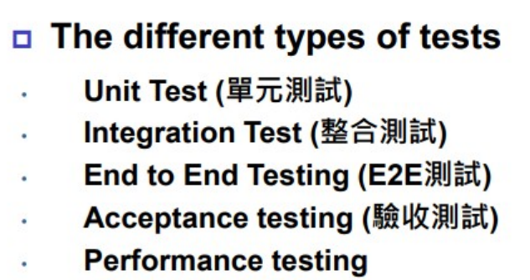
About Testing
Notes:
在github 上的testing有這三個
unit testing就那樣，較鎖碎。
integration testing我們就試做一個worker的I/O測試
performance testing我們目前只很naive的用最近一週的近500個job，讓四個worker去處理，大概要花200秒才能消化完並算出word count，所throughput大概是每秒2.5個job。
其它可以做performance的

Slide 37
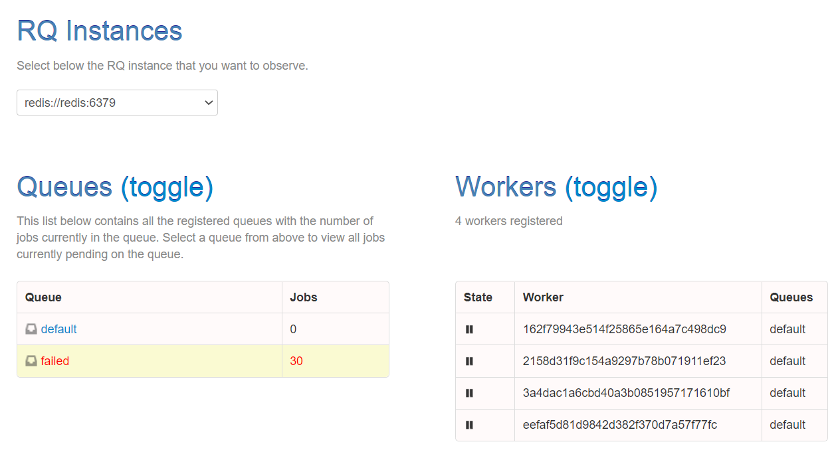
About Monitor
RQ dashboard link: http://34.120.17.241/rq/
Notes:
所以我們就另外試做了這個RQ dashboard來當做monitor。

Slide 38
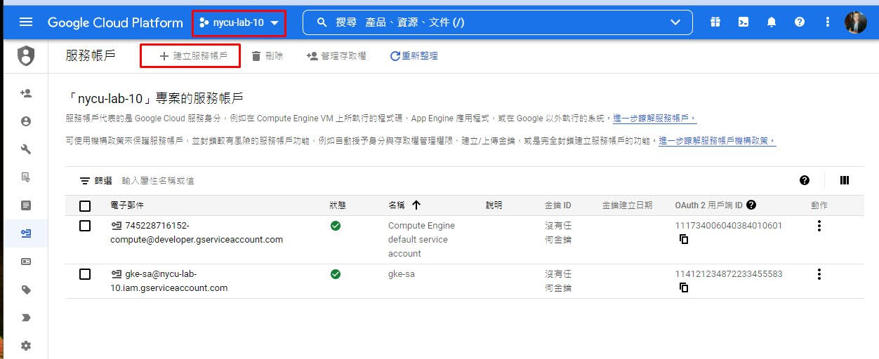
Issues about CD-1

Slide 39
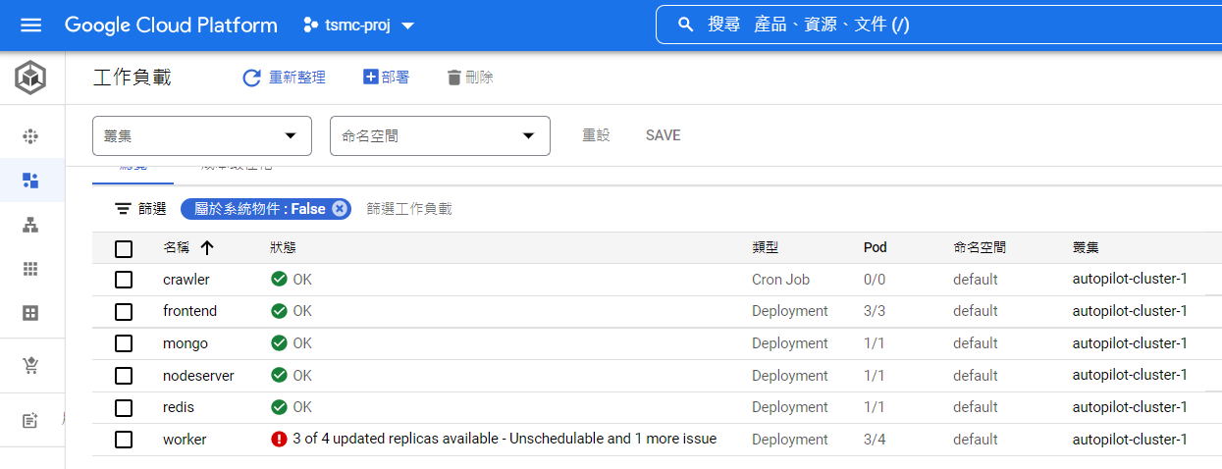
Issues about CD-2 (gke-cluster pods)

Slide 40
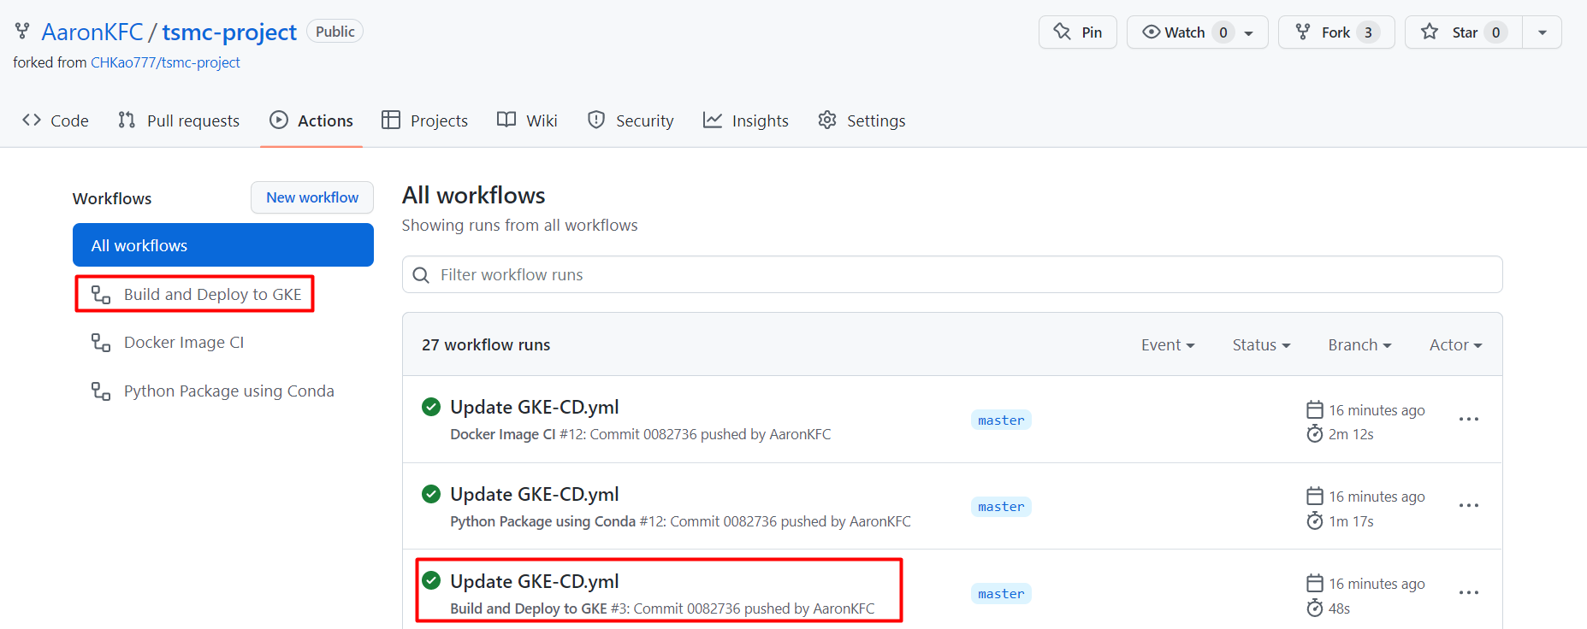
Issues about CD-3 (github-action workflow)
Service link: https://github.com/AaronKFC/tsmc-project/actions

Slide 41
Conclusion

Slide 42
Conclusion
Type | Category | Remark
Basic | Upload codes to Github | version control
 | Deploy to GKE | use GKE Autopilot to build cluster
 | Digital Business: Internet volume changes | word count weekly from Dec. 2021 to May 2022
 | Application Architecture | GoogleCrawler, Workers, Web Server…
 | Code Optimization | architecture optim, improve reliability, SRP
 | Testing Coverage | unit test, integration test
 | CI | Github Action, Pytest coverage
 | CD | 1.Github Action push Docker Image to Dockerhub 2.we don't have permission of GKE service account
Option | Application Monitor | RQ dashboard, url count, worker performance
 | Use Database | schema, MongoDB, Redis
 | Code Contribution | relative to sample codes
 | Ingress | http://34.120.17.241/
Notes:
simple

Slide 43
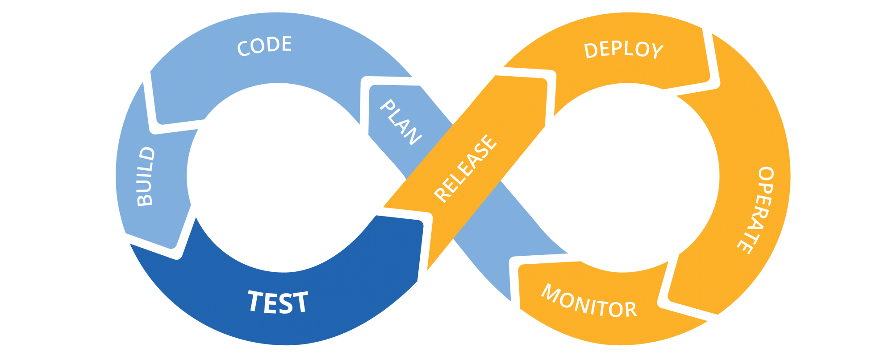
DevOps Sharing
CI
CD
Notes:
從這次的專題中，我們終於實際體會CICD是怎麼一回事。
像左邊CI的部分，如果是自幹的話，大概就是先coding，然就local building跟testing就結束了。
但正式團隊協作CI的話，從前面的Planing就要把怎麼架到GKE討論進來，coding的部分還要考量maintainable或extenable，
第一次開發是還有local用mini K8 deploy和testing，然後就搬到github上用action來CI testing了。
右邊CD的部分，就是練習佈到GKE上，然後就知道怎麼在cloud上operate，最後思考應該要怎麼monitor，
所以透過這個project，我們就很完整的走一次。

Slide 44
Thank You

Slide 45
Q & A

Slide 47
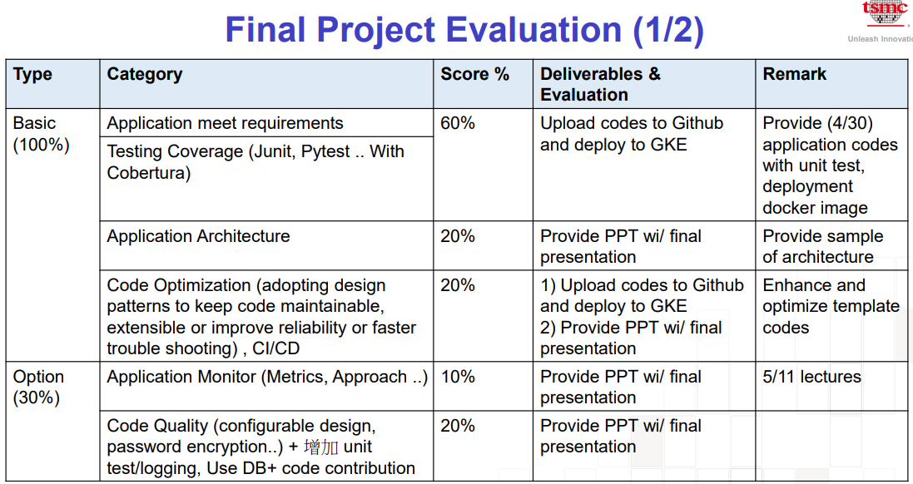

Slide 48
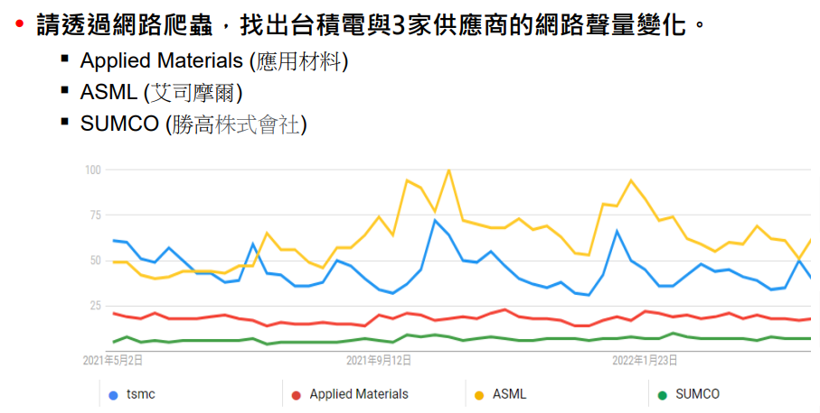
Introduction
Digital Business
Notes:
如果用一句話來總結：Service Mesh 是一組用來處理服務間通訊的網路代理。

Slide 49
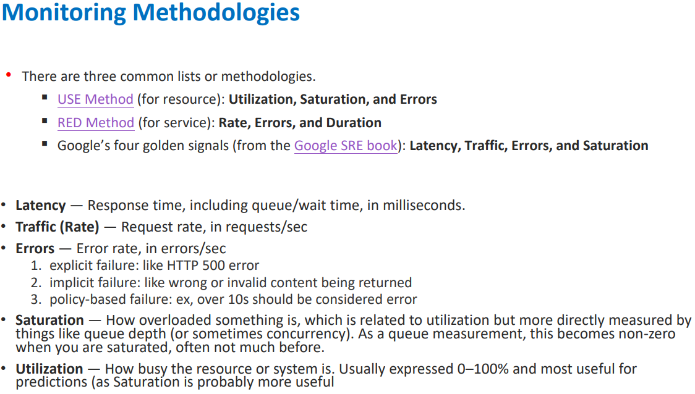
About Monitor
Notes:
這是之前講師上課有提到的monitor方法。
但在我們的專題題目，因為google search有限制，所以我們有設time sleep，休息1分鐘
但就算沒有google search的限制，我們這個題目的transaction volume本來就不大，因為weekly的爬蟲&word count，
然後也因為有sleep，所以request會常常中斷，
因為不管是USE還是RED method好像都沒有試用的。

Slide 50
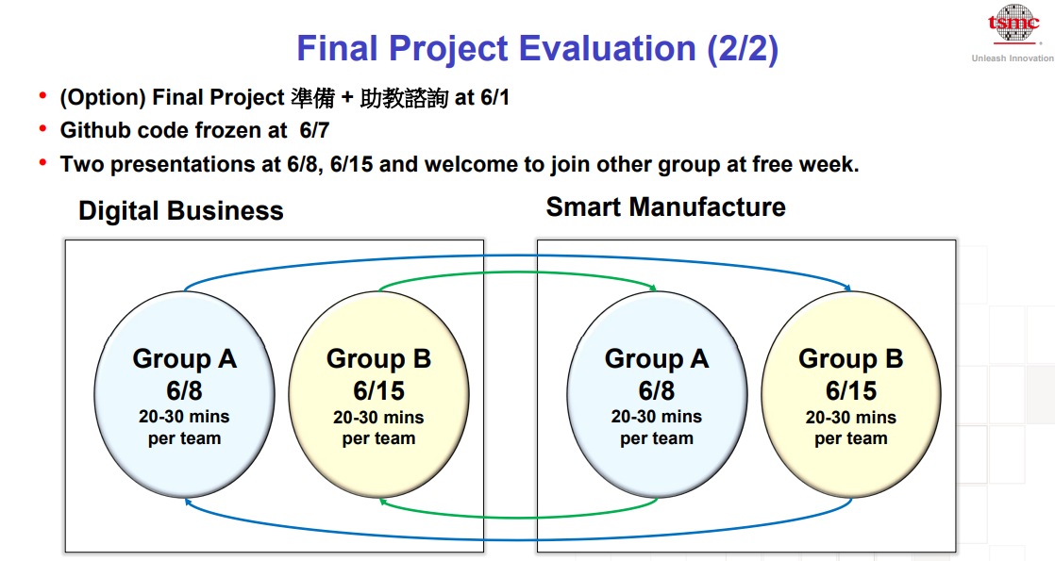

Slide 51
